Slide 1
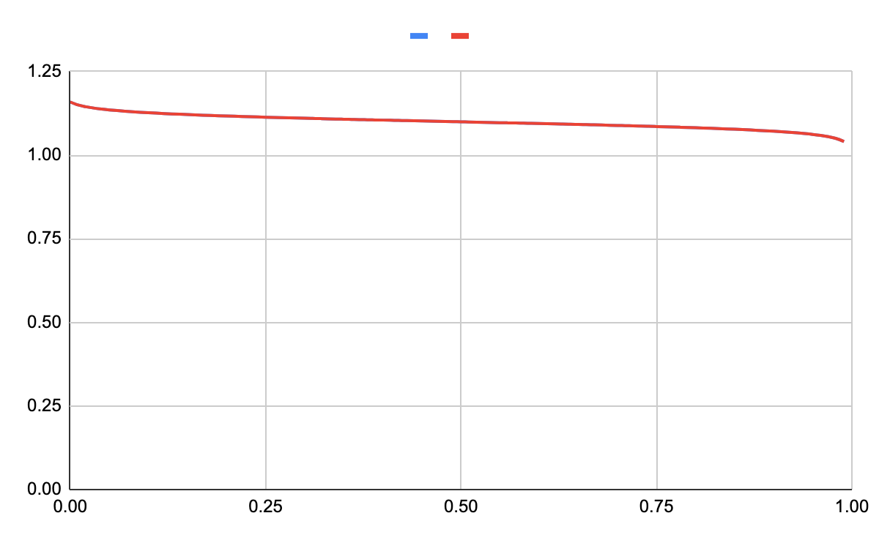
Voltage
None All
Amount of Cu²⁺ reacted

Slide 2
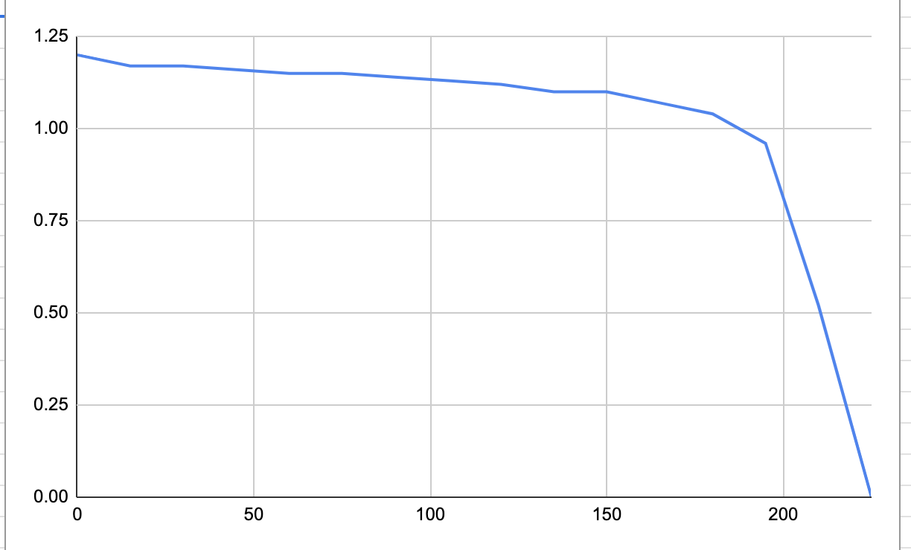
Voltage
Time elapsed (measured every 15 sec)

